Slide 1


Stock Market Prediction

Slide 2

Problem Statment And Objective
Slide Title: Problem Statement
Stock prices go up and down a lot, and it’s hard to guess them correctly.
We chose NVIDIA’s stock to test if machine learning can predict prices well.
Our goal is to build a system that gives better predictions to help people make smarter money decisions.
Slide Title: Project Objectives
Make machine learning models to guess NVIDIA’s stock price for the next day.
Look at old stock data to find patterns and useful information.
Check which model gives the best results using accuracy scores like R².

Slide 3
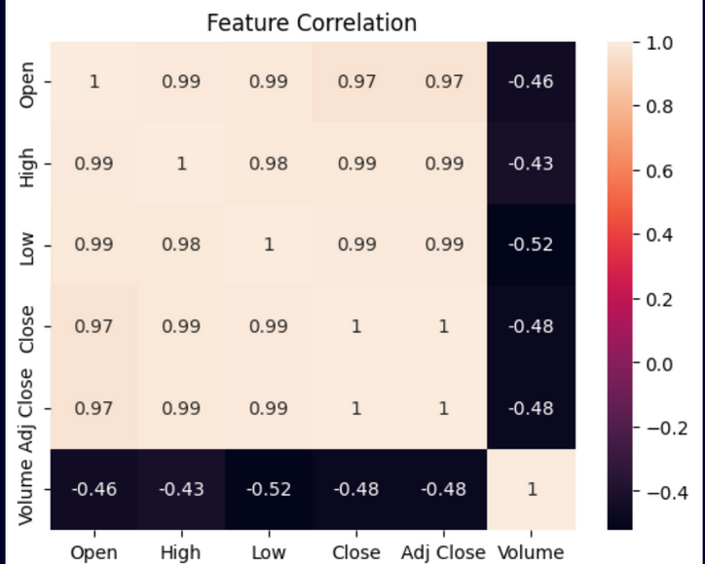
EDA AND DATA PROCESSING
Slide Title: Data Analysis
Checked for missing values and cleaned the data.
Used charts like histograms and count plots to see how the data looks.
Used a heatmap to see how different features are related.
Found that some classes had more data than others, which was fixed later.
Slide Title: Data Preprocessing
Removed columns that were not useful.
Filled or fixed missing data.
Changed text data into numbers using label encoding.
Split data into 80% for training and 20% for testing.

Slide 4
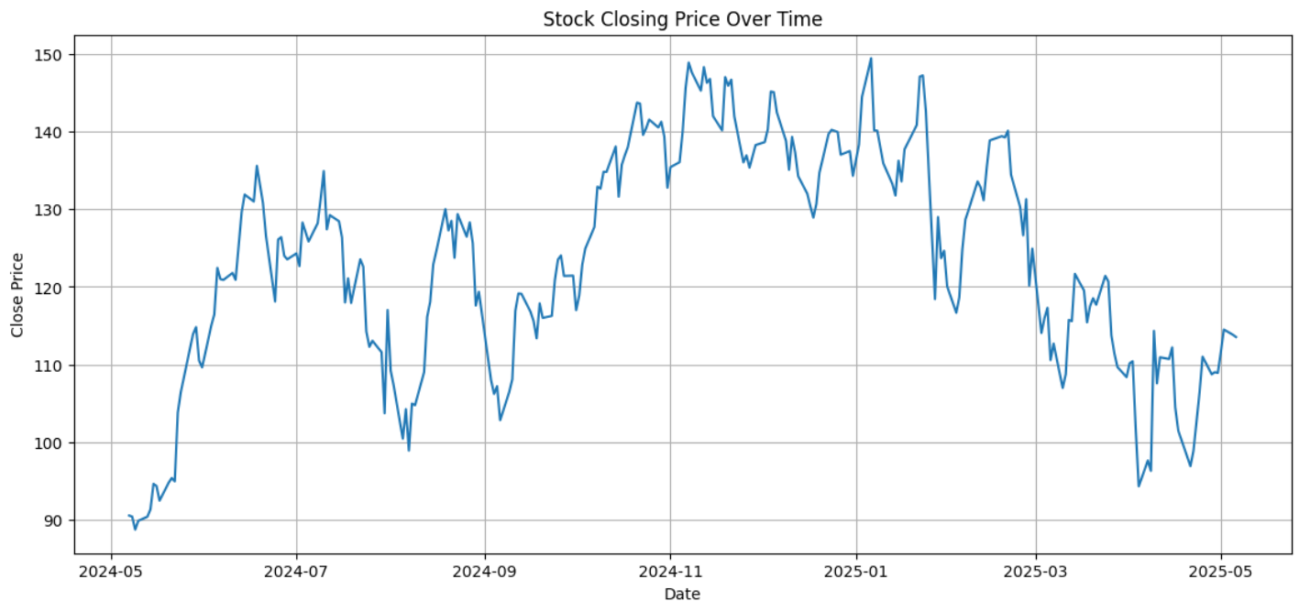
EDA Graph

Slide 5

Methodology
Tools Used: Python, with libraries like Pandas, Matplotlib, and Scikit-learn for data handling, making charts, and building models.
Target Users: Stock professionals and researchers who want to predict the next day’s stock closing price using data like Open and Volume.
Models Tested: Used models like Linear Regression, SVR, Random Forest, Lasso, Ridge, and ElasticNet.
Data Used: Stock data from Yahoo Finance (Date, Open, Close, Volume), cleaned and prepared for training.
Results: Lasso, Ridge, and ElasticNet gave the best results with 85% accuracy.

Slide 6
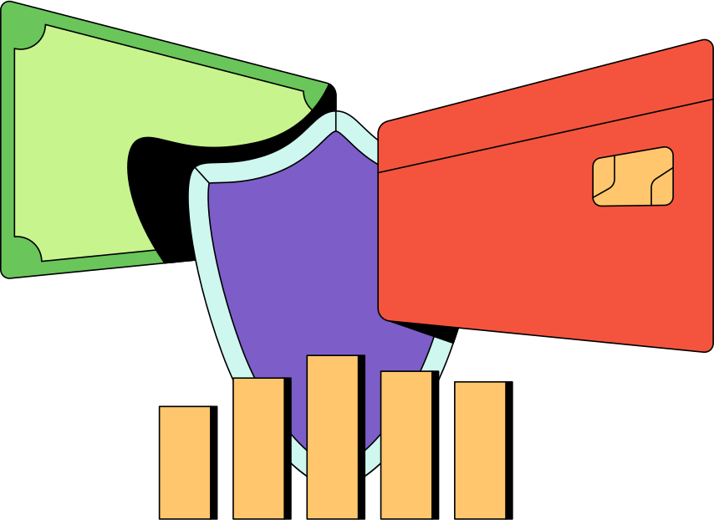
Literature Survey
Predicting stock prices with machine learning is a well-known topic.
Patel et al. (2015) used NSE data and found that Random Forest was the best model, better than SVM and ANN.
Kumar and Ravi (2016) showed that Decision Tree achieved 84.3% accuracy, while KNN gave 80.2%.
Some models use LSTM with technical indicators like moving averages and can reach 91.2% accuracy.
Deep learning needs more data and computing power than traditional methods.
Linear Regression and KNN are still popular for their simplicity, with accuracy between 60% and 75%.

Slide 7

CONCLUSION AND FUTURE OUTLOOK
Conclusion:
Successfully implemented multiple regression models to predict NVDA stock prices.
Lasso, Ridge, and ElasticNet models provided the most consistent and accurate predictions.
Data preprocessing, feature engineering, and model evaluation were effectively applied.
Future Outlook:
4. Plan to include real-time data feeds and live dashboards for continuous prediction.
5. Future versions may use advanced models like LSTM for improved time-series accuracy and scalability.

Slide 8

RESULTS
Slide Title: Model Performance
Lasso, Ridge, and ElasticNet Regression gave the best results with R² ≈ 0.85.
Random Forest Regressor also did well with R² ≈ 0.79, showing it generalizes well.
Support Vector Regressor (SVR) performed the worst with R² ≈ 0.44, meaning it didn’t fit the data well.
We used R² Score, Mean Squared Error (MSE), and Root Mean Squared Error (RMSE) to evaluate the models.
The final model could predict the next day’s stock price with high reliability.

Slide 9
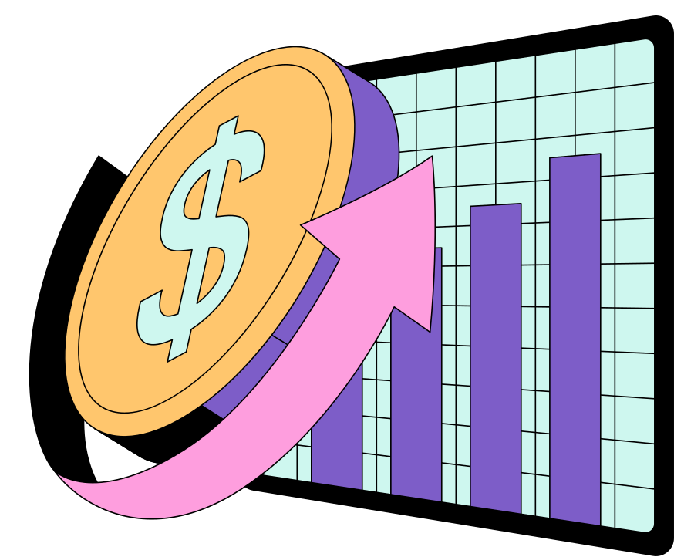
THANK YOU

